Slide 1
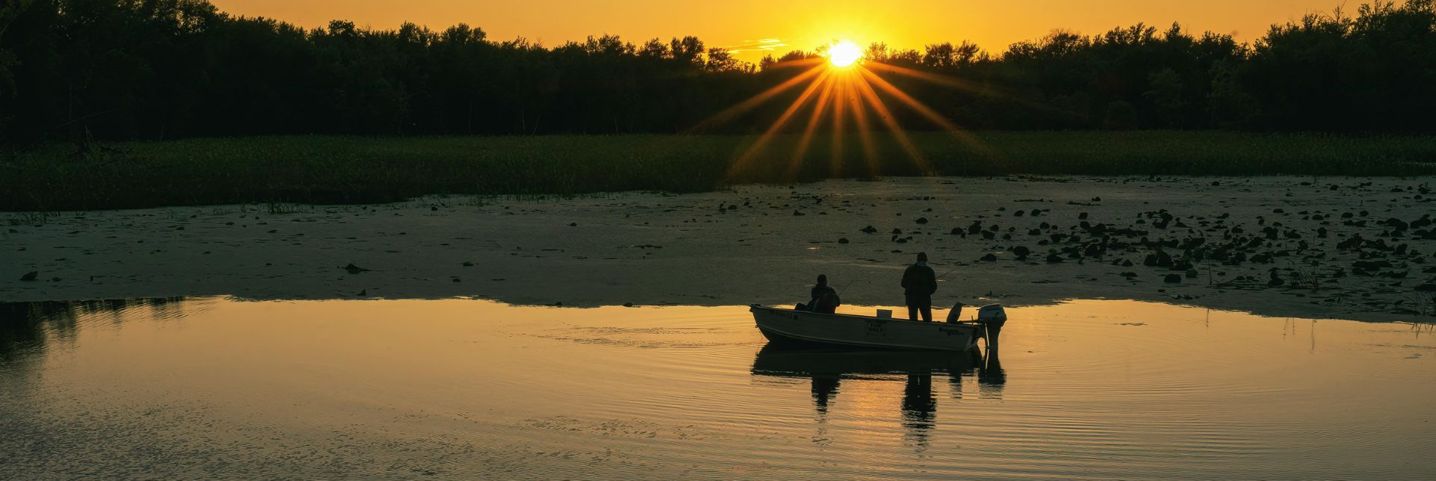


ORBFHP FY27 RFP
Informational Meeting
We’ll get started shortly
Questions? pvanvalkenburg@americanrivers.org

Slide 2
Agenda
Welcome
Program overview
Eligibility
Evaluation criteria
Lisa Hollingsworth-Segedy | American Rivers, Director of River Restoration
Jerry Sweeten | Ecosystem Connections Institute, Senior Ecologist
Kevin Haupt | USFWS, Lead Fisheries Biologist and Principal Investigato
Q&A

Slide 3
Ohio River Basin Fish Habitat Partnership FY27 RFP is looking for projects that…
Are collaborative, science-based - especially in mapped priority areas - that protect, restore, reconnect, or enhance fish and mussel habitat in the Ohio River Basin while delivering durable, measurable benefits for aquatic resources and the public.

Slide 4
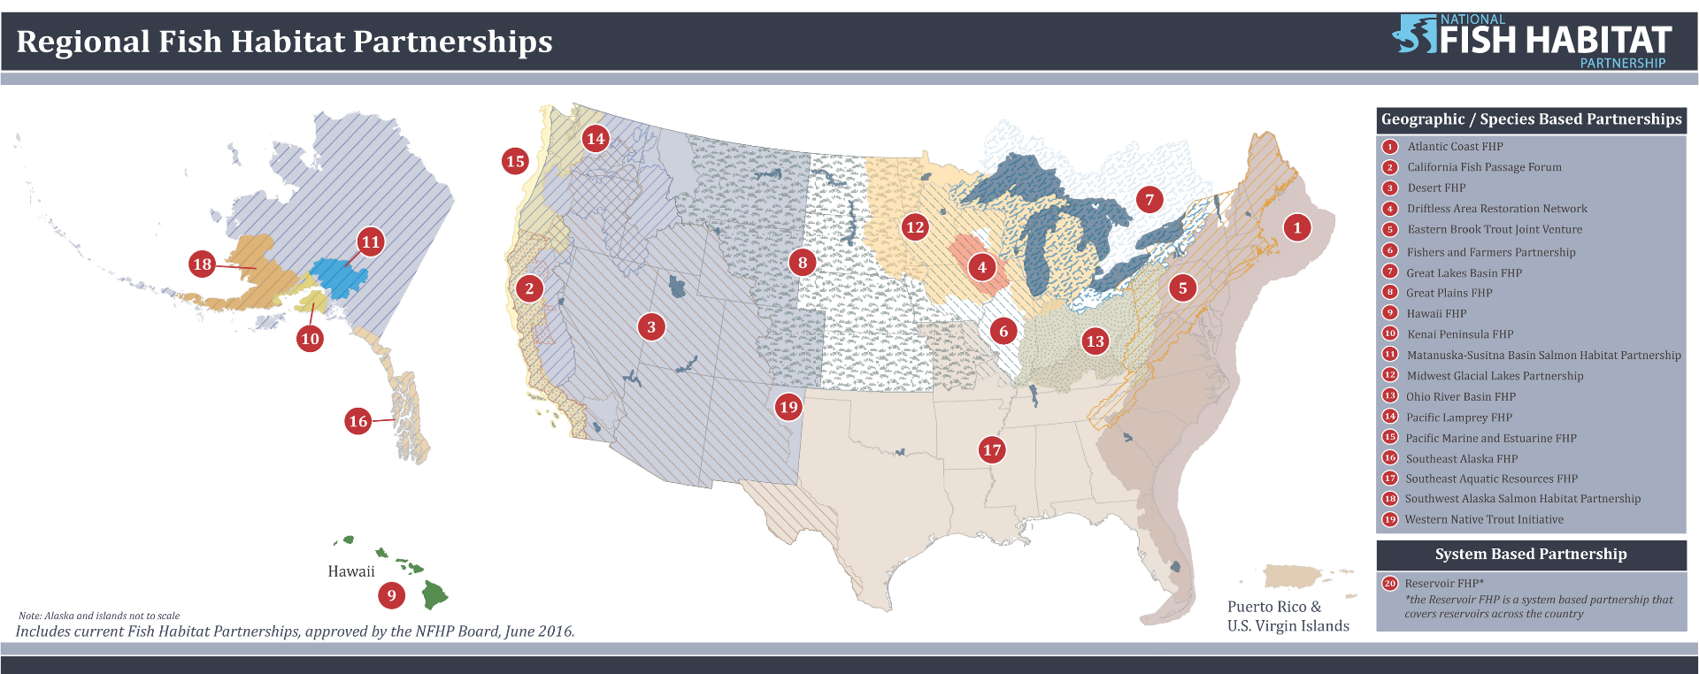
Program goals & funding overview
The National Fish Habitat Partnership

Slide 5
Program goals & funding overview
The National Fish Habitat Partnership (NFHP) receives funding
Through the ACE Act (America’s Conservation Enhancement Act of 2020)
Which codified NFHP into federal law

Slide 6
Program goals & funding overview
The ACE Act authorizes the program
Congress must still provide funding through annual appropriations process (administered by USFWS)
Regional fish habitat partnerships (like ORBFHP) identify, prioritize, and recommend projects for consideration

Slide 7
Match requirements
A 1:1 non-federal match is required.
A 3:1 non-federal match is encouraged.
Match may include allowable cash and documented in-kind contributions.
Federal funds may be identified as leveraged funding but cannot satisfy the required non-federal match.
NFHP funding cannot be used as match for another federal award.

Slide 8
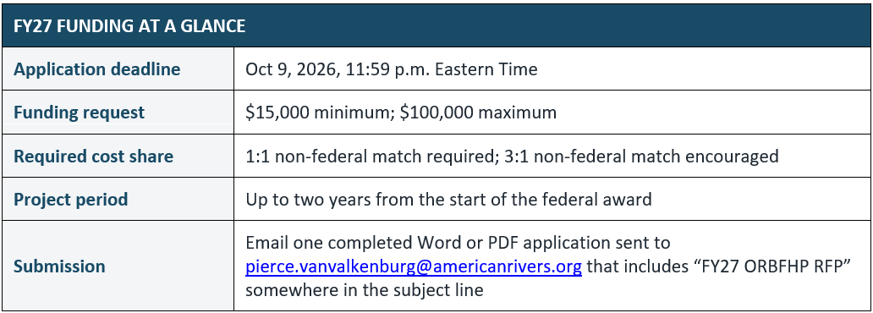
Other Info

Slide 9
Required Materials
The completed FY27 RFP/application document
Project location map
Itemized project budget (completing Section 6 is acceptable. If you have additional itemized information, attach it)
Documentation supporting cash or in-kind match commitments
Relevant plans, designs, permits, photographs, or technical materials, if available

Slide 10
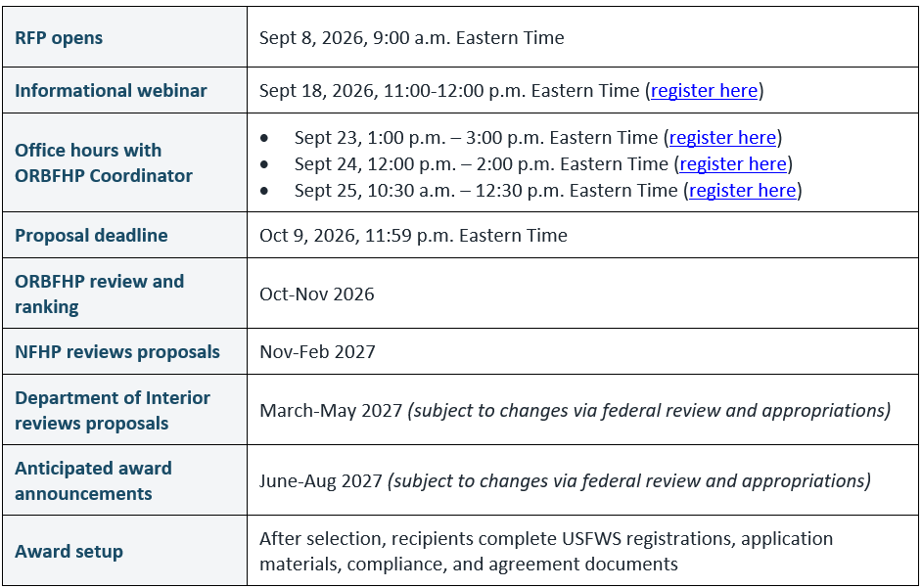
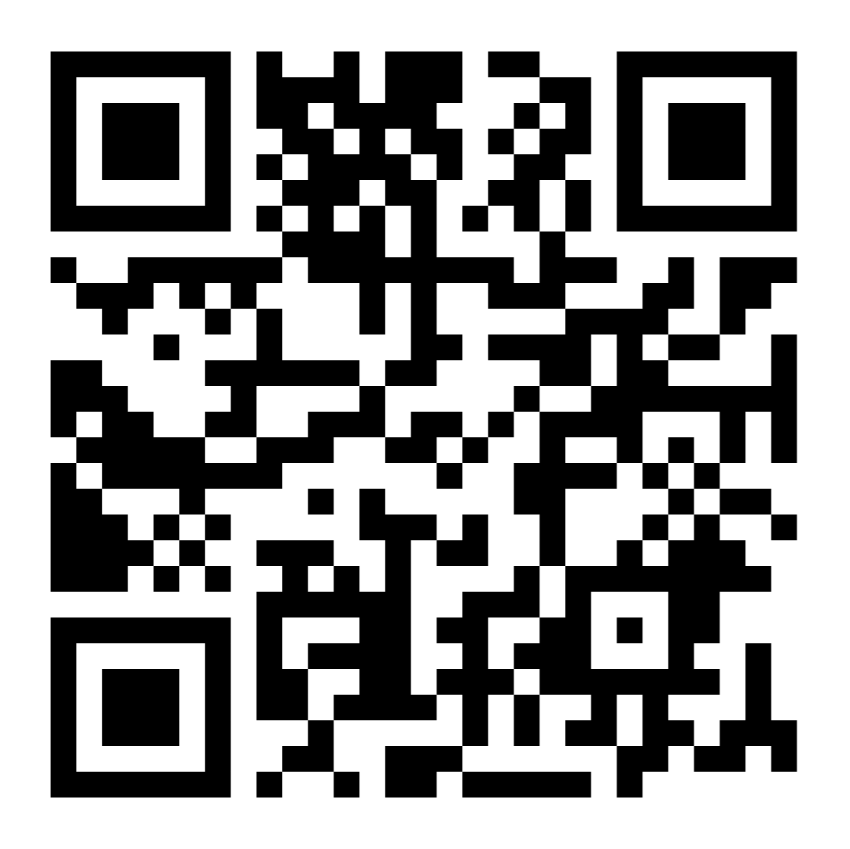
Register under “TIMELINE”
Application Process

Slide 11
Who Can Apply
Nonprofit and watershed organizations
Tribal governments and organizations
State and local government agencies
Universities and research institutions
Conservation districts and similar public entities
Other organizations working with landowners and conservation partners

Slide 12
Agenda
Welcome
Program overview
Eligibility
Evaluation criteria
Lisa Hollingsworth-Segedy
Jerry Sweeten
Kevin Haupt
Q&A

Slide 13
Funding Stages & Activities we Support
Funding Stages we Support
Planning & Assessment
Engineering & Design
On-the-ground implementation
Funding Activities we Support
Restore Habitat
Reconnect Habitat
Improve Conditions
Measure & Inform
Habitat enhancement | Barrier removal | Riparian restoration | Project monitoring
Stream and floodplain restoration | Fish-passage improvements | Water-quality improvements | Action-oriented assessments and data tools

Slide 14
Disqualifications
Incomplete/late applications
Outside of ORBFHP geography
Applicant unable to receive USFWS financial-assistance award
Requests more than $100,000
Does not address an ORBFHP strategic priority / does not ID measurable fish-habitat outcome

Slide 15
Agenda
Welcome
Program overview
Eligibility
Evaluation criteria
Lisa Hollingsworth-Segedy
Jerry Sweeten
Kevin Haupt
Q&A

Slide 16
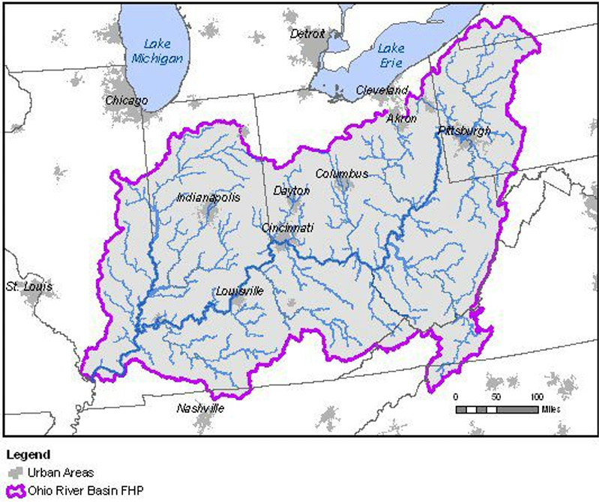
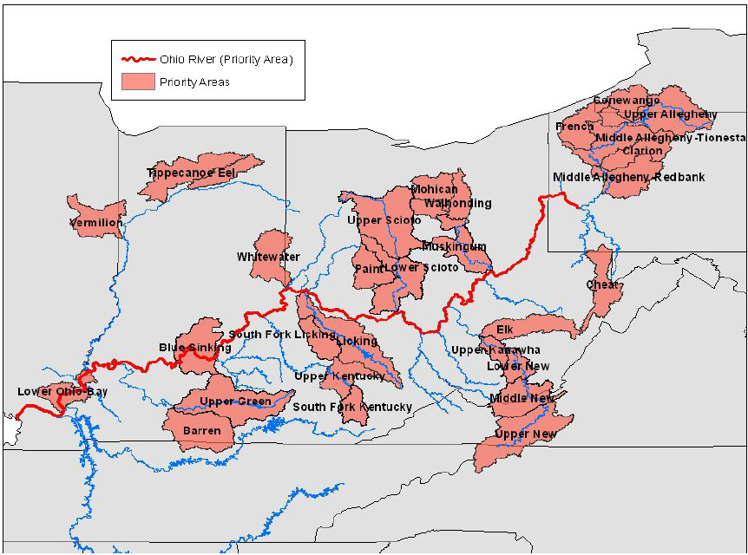
A Strong Proposal…

Slide 17
A Strong Proposal…
Addresses ORBFHP’s Strategic Plan (https://orbfhp.com/strategic-plan/)
Addresses a national plan (ex: State Wildlife Action Plan, recovery plan, Tribal plan, watershed plan, climate plans, fishery plan, etc)
Measurable and durable benefits with monitoring and budget
Benefits recreational fishing (directly or indirectly)
TL;DR – answer every Q in the RFP, and you’ll be on the right track

Slide 18
Questions?
Sign up for office hours next week for further assistance: orbfhp.com/funding
→ “Timeline”
pvanvalkenburg@americanrivers.org

